Slide 1
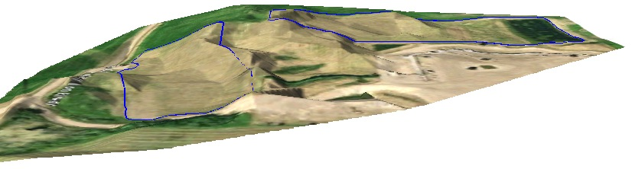
Introduction to GIS Short Course
Day 1 Introduction

Slide 2
My Background
Not in GIS!
Environmental Science at Acadia
Environmental Scientist/Project Coordinator at GeoGrid Environmental
M.Sc. Geology at Acadia
Use Geographic Information Systems in all 3
Applied, Pragmatic approach to GIS

Slide 3
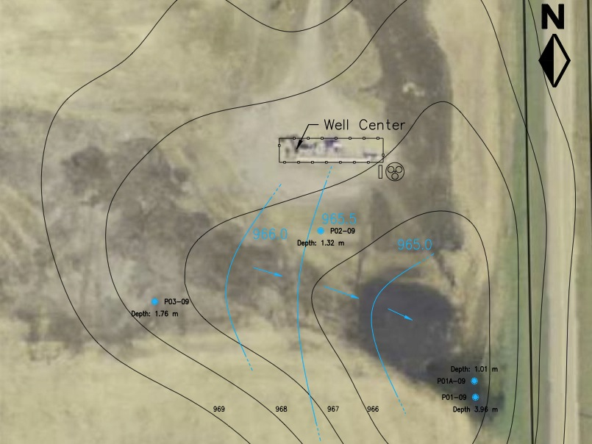
Elevation contours and water table contours of a spill site in Wimborne, Alberta

Slide 4
Cut and fill diagram of a site in Elk Point, Alberta
Excavated View
1989 View
Final Contour

Slide 5
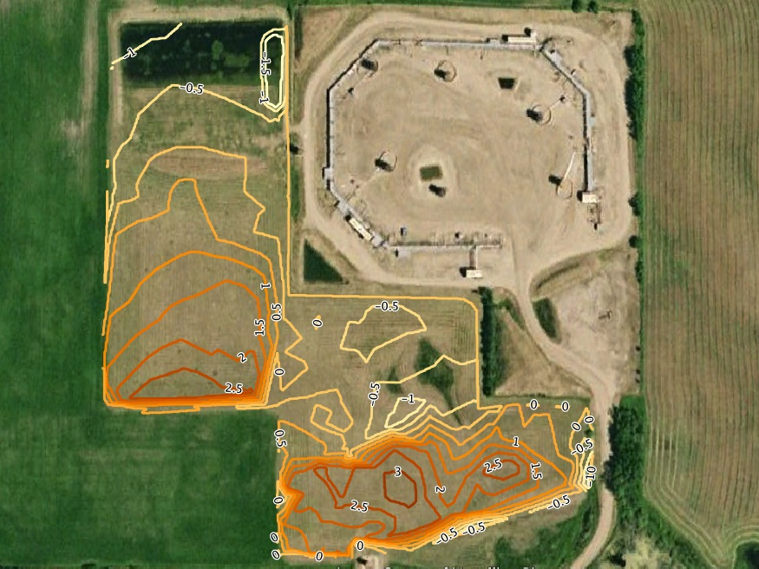
Cut and fill diagram of a site in Elk Point, Alberta

Slide 6
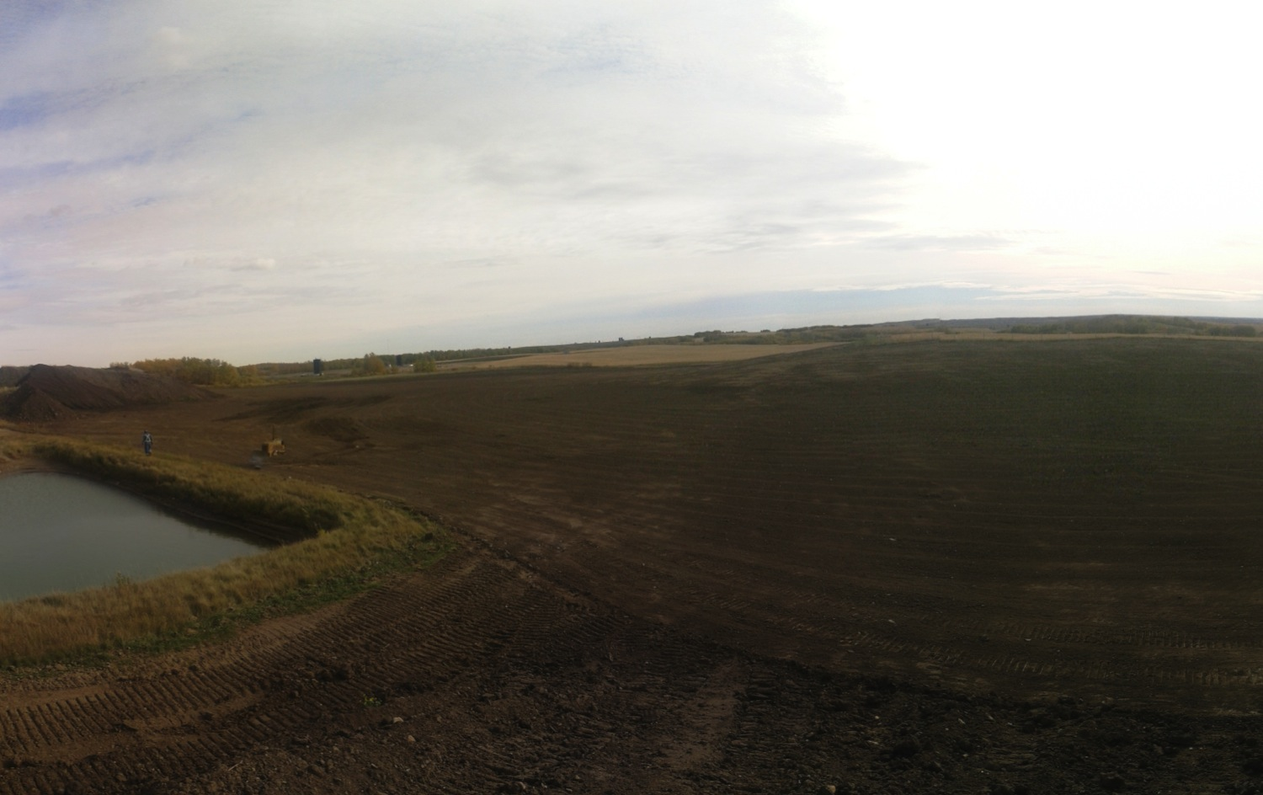

Slide 7
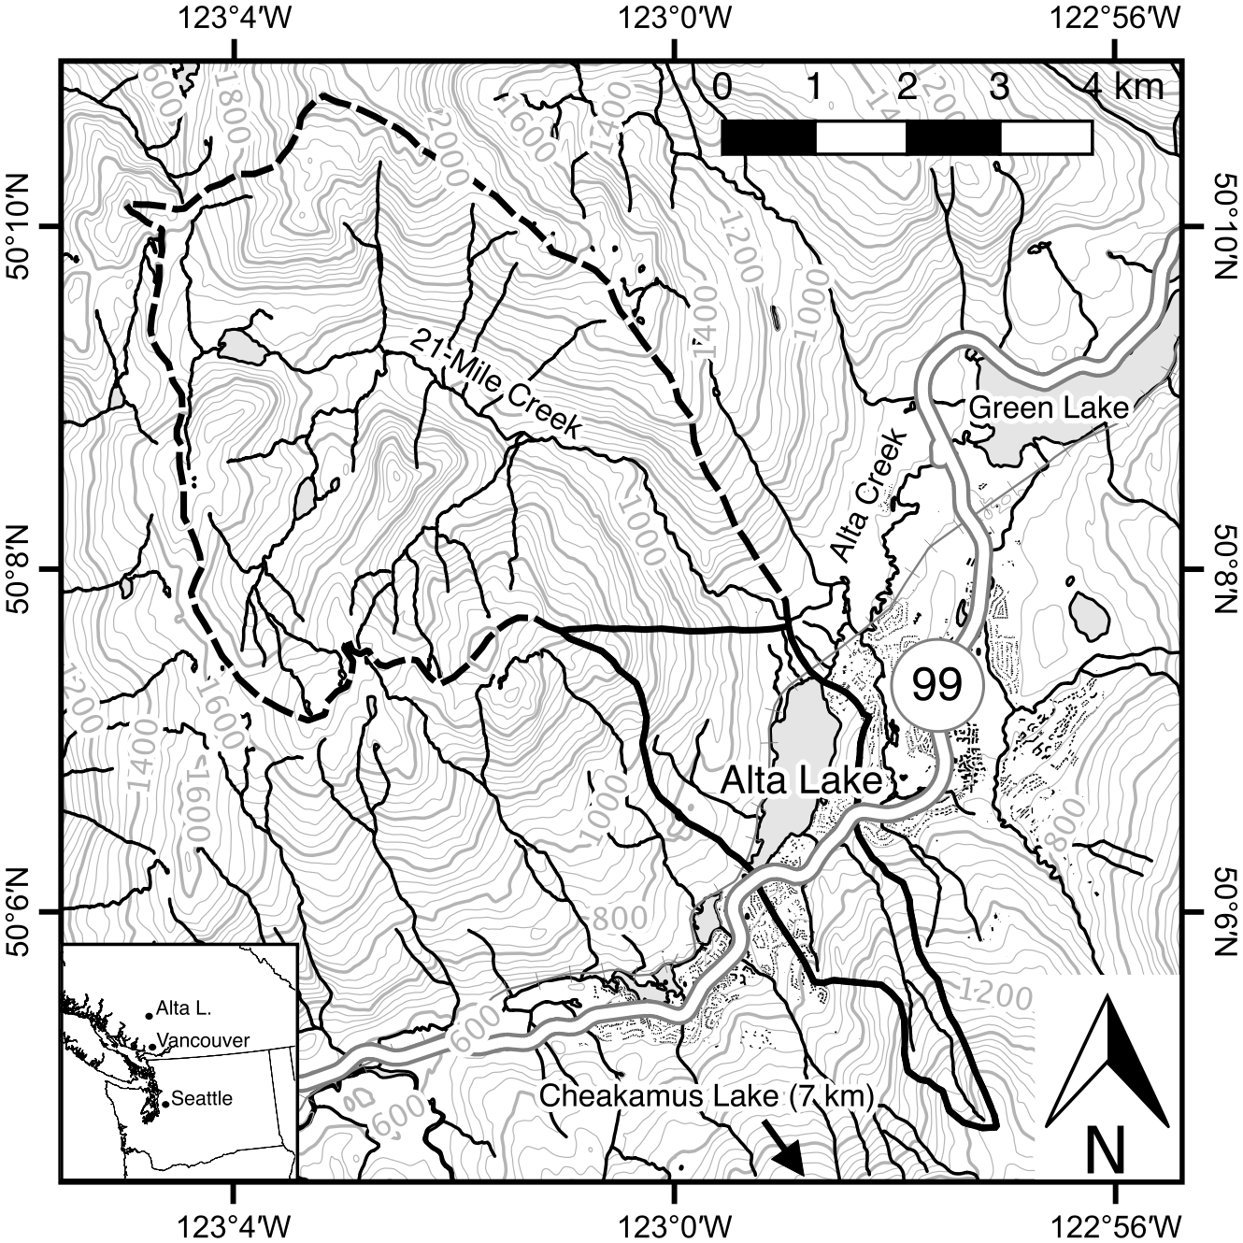

Slide 8
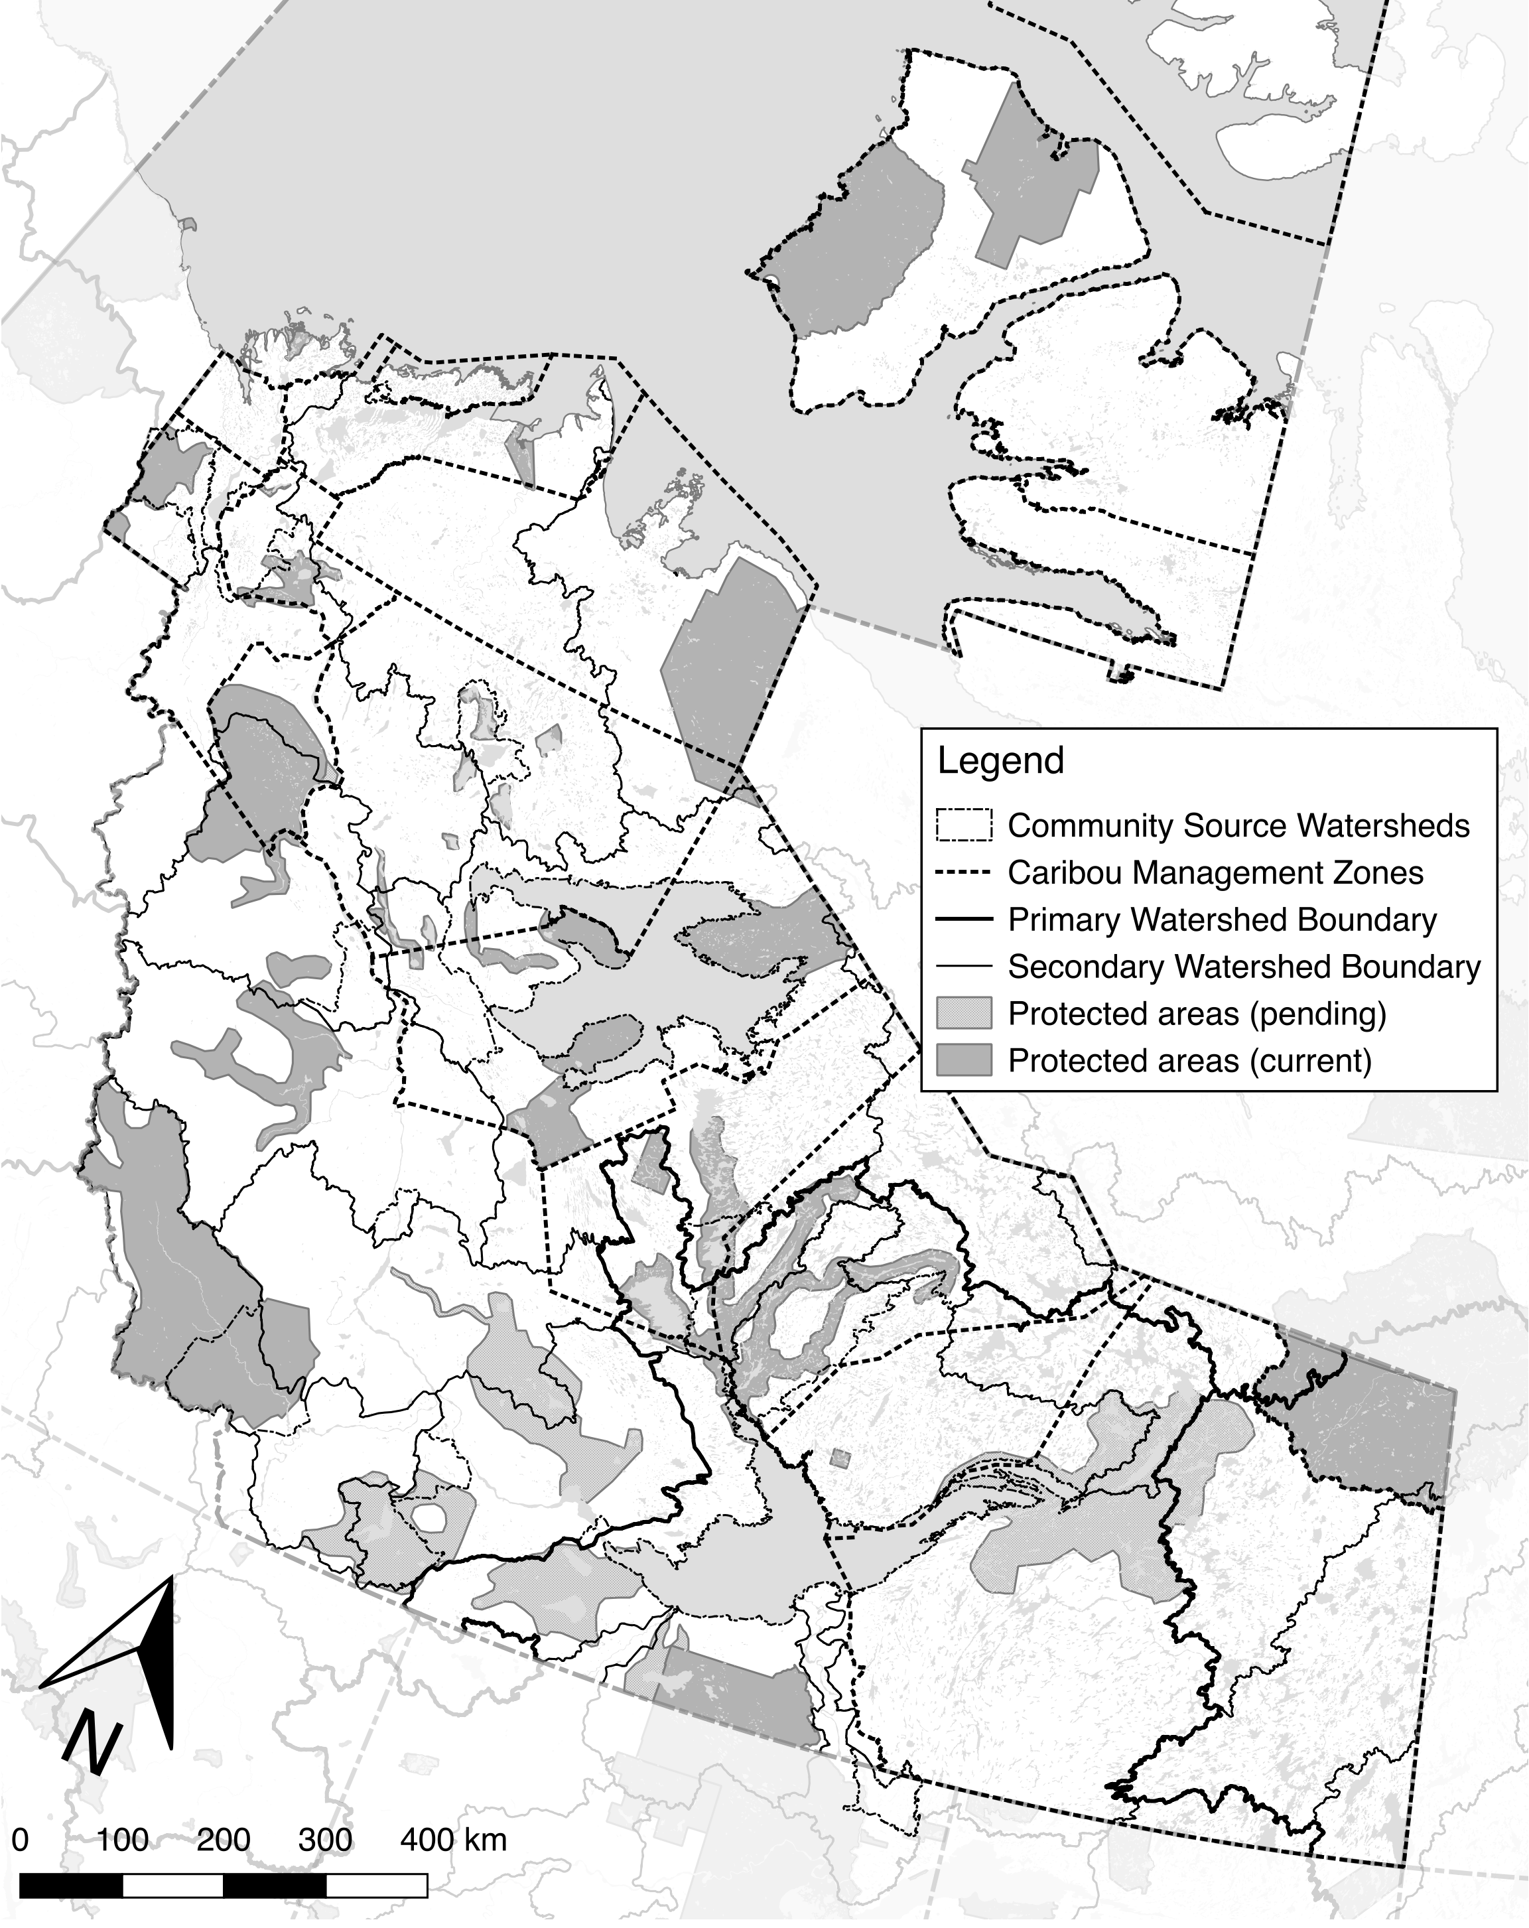

Slide 9
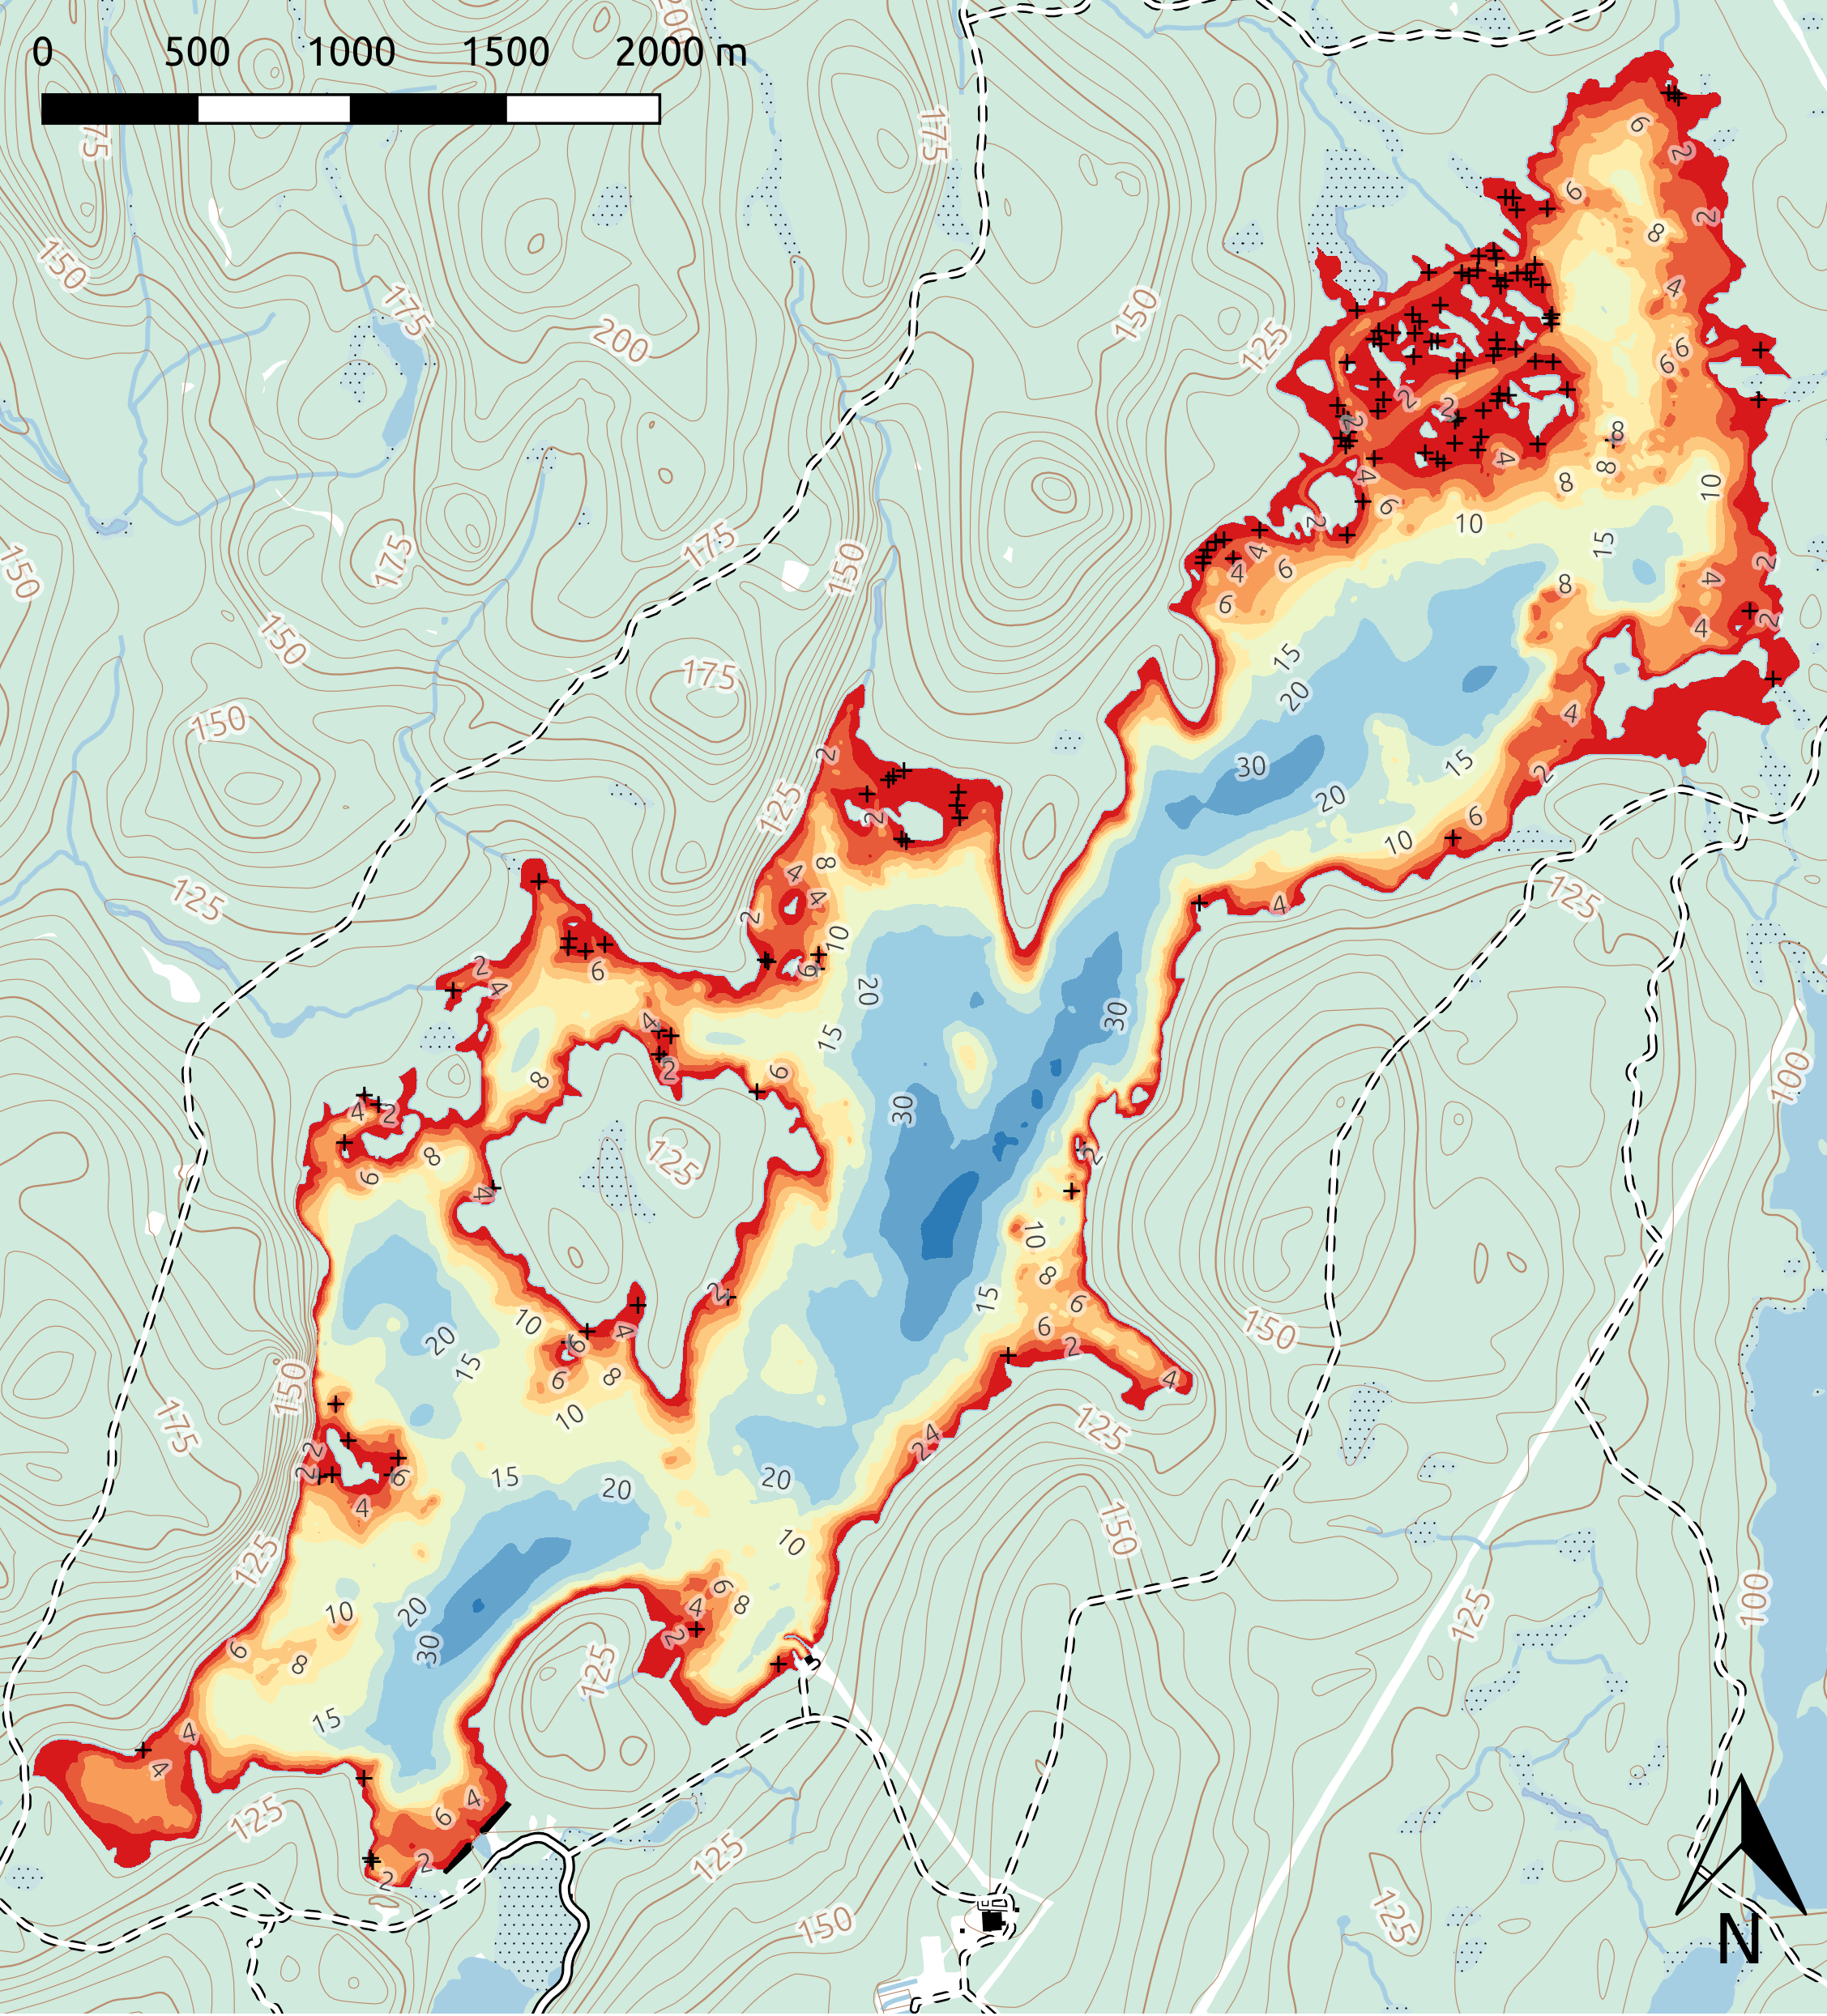

Slide 11
What is Geographic Information?
GIS = Geographic Information System(s)
Geographic Information is any information with a location associated with it (so, everything)
Any information you can put on a map
(and want to)

Slide 12
Standard NTS Topographic Map

Slide 13
Why do we bother?
Often a map is the best way to present and analyze information with a geographic component.
Maps allow us to view multiple types of information together (“layers”) to make connections.

Slide 14
Introduction to GIS Short Course
Day 1: How do you make a map in QGIS?
Add data to the map
Format the data to look pretty
Export/Print the map
Getting your data into QGIS

Slide 15
Introduction to GIS Short Course
Day 2: Creating, importing, and manipulating GIS Data
Make a map of your study sites
Create and edit data in QGIS
Interpolation and contouring (Raster processing)
Vector data analysis
Going over participant projects

Slide 16
Assignments
During each module you will:
Create a QGIS Project
Create a PDF of the map you made in that module
Save the QGIS Project (and any data you generate during that module) in the correct folder.
You “must” complete these tasks!

Slide 17





GIS Applications
GIS = Programs that work with geographic data
Google Earth (free to $400/year)
ESRI ArcGIS ($1500 base license, $4000 per extension; free basic versions available)
GRASS, QGIS (“free” or by donation)
MapInfo ($1995)
Whitebox GIS (also free)

Slide 18
GIS Applications
All have same set of features:
Basemaps
Ability to add/edit/view geographic data (some free versions don’t allow editing)
Analysis Tools
We will be using QGIS because:
It doesn’t cost money to install
It works (and works well) on multiple platforms
There is no license restriction (you can use it forever)

Slide 19
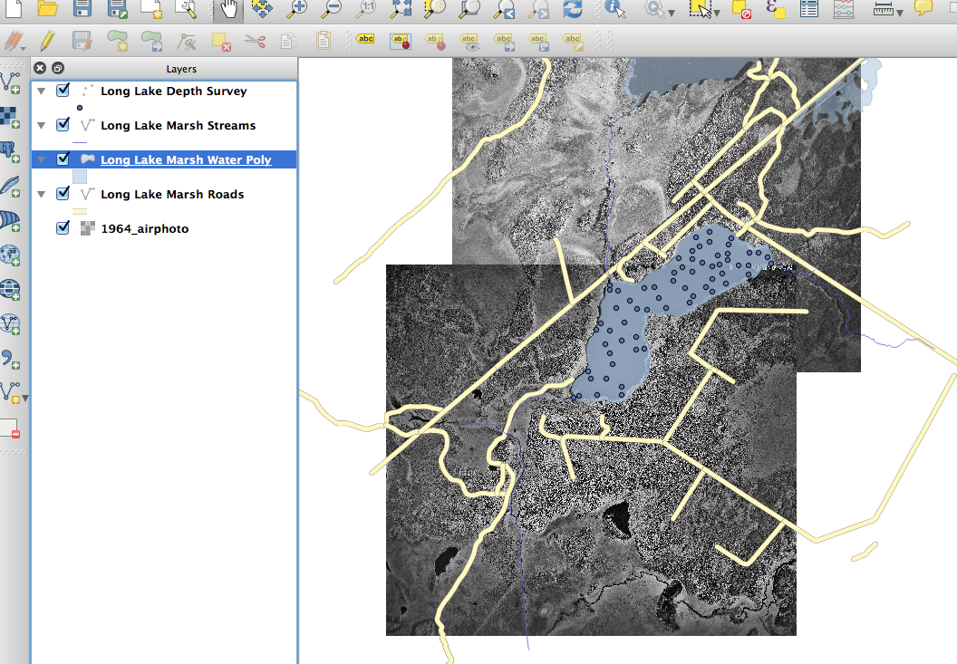
How is GIS Data Organized?
GIS Data is organized in layers
Each layer contains similar data that is usually displayed in a similar way.
Layers

Slide 20
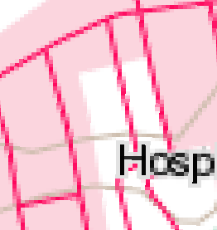
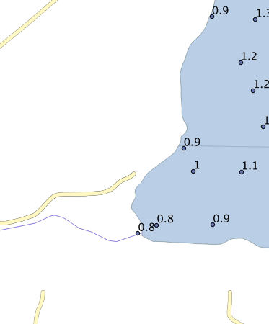
Types of Layers
Raster Layers
Contain a grid of data with a data value in each square
Can be color data (like a picture)
Can be other data (like elevation, concentration)
Vector Layers
Contain a collection of points OR lines OR polygons (“features”)
Also contain data about these features (Sample number, elevation, depth, strike, dip; known as “attributes”).
The power of GIS if often in comparing layers with each other and examining relationships.

Slide 21
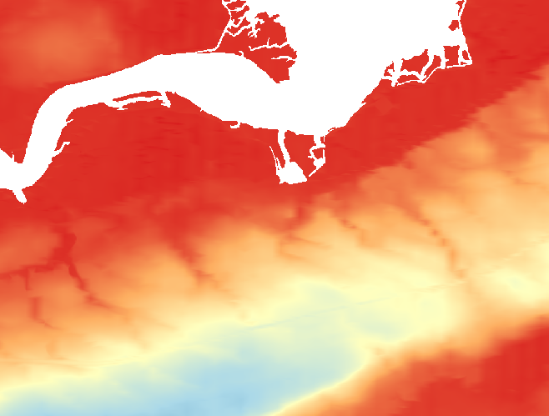
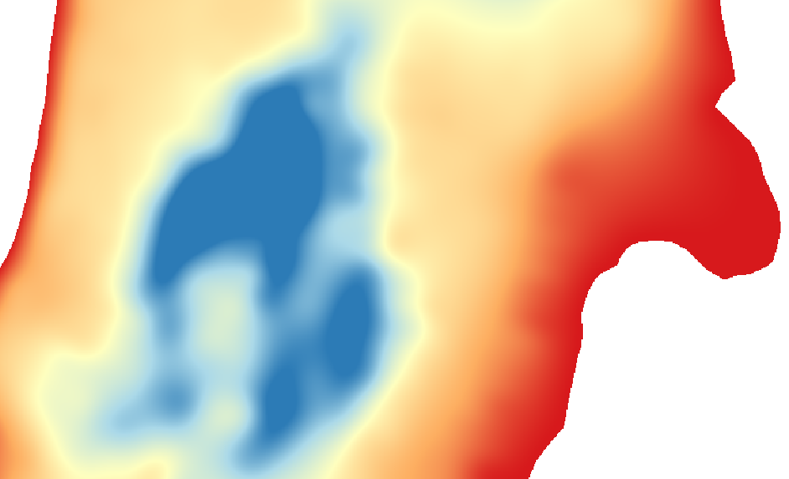

Raster Layers
Can be displayed in a variety of ways – “color ramp” (shown below), grayscale, several discrete colors.
For any point on the map, you can obtain a value from a raster.
Also called a “surface”

Slide 22
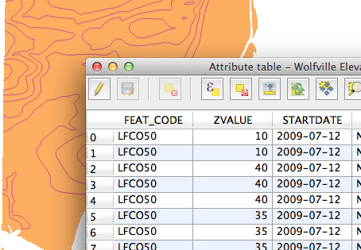
Vector Layers
Made up of one or more “features” that have “attributes”
Point OR line OR polygon features in a single layer

Slide 23
Vector Data
Points
Lines
Polygons
Features, Fields, Attributes

Slide 24
How could the following data be represented?
Soil conductivity (Points, Contours)
Water table depth (Points, Contours)
Sample locations (Points)
Strike & dip (Points, Contours)
Slope steepness & direction of slope (Points, Contours)
Roads (Lines, Polygons)
Habitat suitability (Polygons)
Bedrock type (Polygons)

Slide 25
Identify the “layers” present, and their types

Slide 26
Identify the “layers” present, and their types

